Slide 1
Management of Surgical Smoke Tool Kit
Part V: Additional Perioperative Nursing Care

Slide 2
Instructions to the Learner
This tool kit contains five slide decks related to the management of surgical smoke in the perioperative setting. We recommend that you review the slide decks in order. This is Part V.
Part I: Introduction to Surgical Smoke
Part II: Hazards of Surgical Smoke
Part III: An Overview of Health Care Regulations, Standards, and Guidelines Related to Surgical Smoke
Part IV: Smoke Evacuation in the Perioperative Setting
Part V: Additional Perioperative Nursing Care

Slide 3
Part V
Additional Perioperative Nursing Care

Slide 4
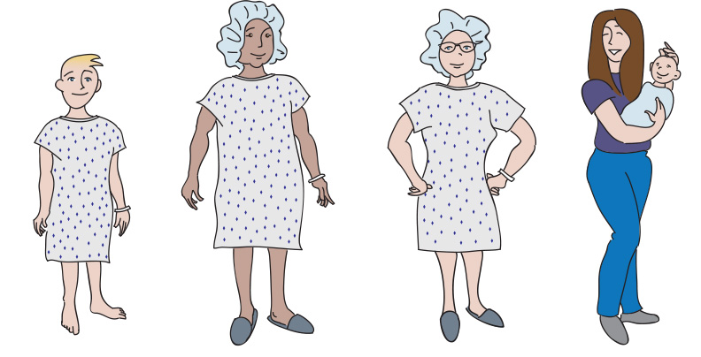
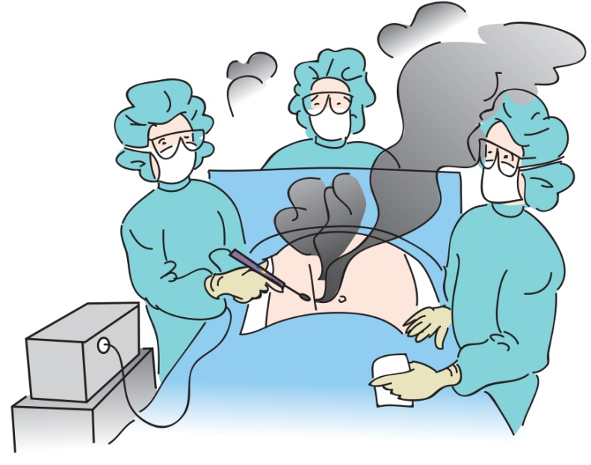
Perioperative Nursing Care
Notes:
Now let’s describe additional perioperative nursing care interventions to protect patients and health care professionals from the hazards of surgical smoke.

Slide 5
Perioperative Nursing Care
Patient assessment
Will your patient be exposed or potentially be exposed to surgical smoke?
Diagnosis
Planning care
Interventions and evaluation of outcomes
Patient outcomes
Notes:
During a patient assessment, the perioperative nurse should determine whether surgical smoke will be generated during the procedure. Planning for the procedure involves ensuring that appropriate smoke evacuation devices are available, are in good working order, and will be used properly during the procedure.

Slide 6
Surgical Attire
Remember that general room ventilation and smoke evacuation are the first line of protection from surgical smoke.
Wear appropriate PPE.
Notes:
As a reminder, wear the appropriate PPE for expected or actual exposures to surgical smoke.

Slide 7
PPE: Masks
Surgical masks and high-filtration surgical face masks
Fluid resistant, loose-fitting face mask
Protects wearer from large droplets, splashes, sprays
Not a reliable way to protect wearer from inhaling contaminants
Does not create a seal between the wearer’s face and the mask
Notes:
It is important for perioperative team members to wear appropriate respiratory PPE to protect them from inhaling surgical smoke. Surgical masks and high-filtration surgical face masks are fluid resistant; are loose fitting; and protect the wearer from large droplets, sprays, and splashes from bodily fluids. Neither type of mask is a reliable way to protect the wearer from inhaling contaminants. They do not create a seal between the wearer’s face and the mask.

Slide 8
PPE: Masks
High-filtration surgical face mask
Designed to filter particulate matter that is 0.1 micron in size or larger
A surgical mask is not considered respiratory PPE.
Notes:
High-filtration surgical face masks are designed to filter particulate matter that is 0.1 micron ( ie, 0.1 micrometer) in size or larger. A surgical mask is not considered respiratory PPE.

Slide 9
Notes:
As you recall, in Part II we discussed the differences between surgical masks and PPE for respiratory protection related to the hazards of surgical smoke. Perioperative team members should wear PPE (ie, respiratory protection) as secondary protection against residual surgical smoke
Note to instructor: the content below is the same content from Part II. It is placed here for your reference.
General room ventilation and smoke evacuation are the first lines of protection against the hazards of surgical smoke. When respiratory protection is required, the minimum respiratory protection device is a filtering face piece respirator (eg, an N95 respirator). A surgical N95 respirator is fluid resistant on the outside to protect the wearer from splashes or sprays of body fluids. A surgical mask is a loose-fitting face mask intended to prevent the release of potential contaminants from the user into his or her immediate environment. A surgical mask is fluid resistant, providing protection from large droplets, sprays, and splashes of body fluids, but does not give the wearer a reliable level of protection from inhaling small airborne particles. A surgical mask is not considered respiratory protection. A high-filtration surgical face mask is designed to filter particulate matter that is 0.1 micron in size and larger. Similar to a surgical mask, a high-filtration mask does not create a seal between the face and the mask and may allow dangerous contaminants to enter the health care worker’s breathing zone. The evidence demonstrates the measurable superiority in protection provided by a surgical N95 respirator compared with high-filtration and surgical masks, and that surgical masks have inadequate filter performance for aerosols and submicron particles.

Slide 10
Respiratory Protection
Wear PPE (ie, respiratory protection) as secondary protection from surgical smoke.
Minimum requirement is a fit-tested surgical N95 filtering face piece respirator (ie, N95 respirator)
Wear an N95 respirator during
Higher-risk, aerosol-generating procedures
Procedures on patients known or suspected to have aerosol transmissible diseases
tuberculosis (TB), varicella, rubeola
Notes:
It is important to wear respiratory protection, an N95 respirator for higher risk, aerosol generating procedures, as well as, for procedures on patients known or suspected with aerosol transmissible diseases, for example TB, varicella, or rubeola.^{1,2}
References
Benson SM, Novak DA, Ogg MJ. Proper use of surgical N95 respirators and surgical masks in the OR. AORN J. 2013;97(4):457-467.
Guideline for surgical smoke safety. In: Guidelines for Perioperative Practice. Denver, CO: AORN, Inc; 2018:469-498.

Slide 11
Respiratory Protection
Wear a fit-tested surgical N95 filtering face piece respirator for
disease transmissible cases (eg, human papillomavirus [HPV])
aerosol transmissible diseases (eg, TB, varicella, rubeola)
aerosol-generating procedures (eg, bronchoscopy)
Notes:
Using respiratory protection includes wearing a fit-tested surgical N95 filtering face piece respirator or wearing a high-filtration mask during procedures that generate surgical smoke. Perioperative team members should wear a fit-tested surgical N95 filtering face piece respirator when caring for patients with transmissible diseases such as HPV, tuberculosis, varicella, and rubeola, and during aerosol generating procedures such as a bronchoscopy procedure. The high-filtration mask does not seal to the face and may allow contaminants to enter the wearer’s breathing zone. It is important to know what type of masks and respiratory protection methods are available in your facility.

Slide 12
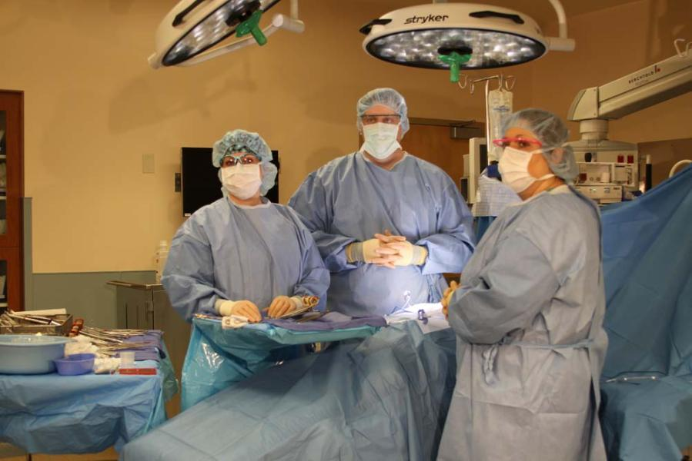
Team Briefing
Communication with the surgeon and perioperative team members
Plan for smoke evacuation
Equipment and optimal placement of equipment
Smoke protection methods for the patient and team members
Notes:
Discuss the required smoke evacuation methods when you are planning and preparing for the procedure and during the team briefing. The team briefing can include the plan for smoke evacuation; the type of equipment and optimal placement of the smoke evacuation device; and patient and team member protection methods, including what type of respiratory protection is recommended.
A smoke evacuation program is much more successful when there is collaboration and communication among all of the perioperative team members.

Slide 13
Hand-Over Communication
Include PPE and respiratory protection/mask options
Type of smoke evacuation method being used
Notes:
During a change in staffing in a procedure and other hand-over communications, it is important to inform the incoming team members about the type of smoke evacuation system in use and the respiratory protection requirements. A reminder to the incoming team members can also include safe handling using standard precautions when disposing of used smoke evacuation equipment and filters.

Slide 14
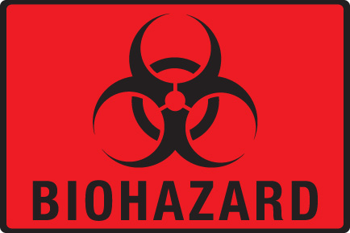
Safe Handling
Use standard precautions when disposing of used smoke filter devices and other used smoke equipment.

Slide 15
Documentation
Relevant information about smoke evacuation and equipment used
Notes:
It’s important to document in the patient’s medical record the relevant information about smoke evacuation and the type of smoke evacuation equipment used.

Slide 16
Policies and Procedures
Address best practices for the patient and the perioperative team
National regulatory and professional standards
Credentials, competency, and training
Equipment
Operational guidelines
Patient and health care worker incidents
Notes:
Policies and procedures should address best practices for smoke evacuation to protect the patient and the perioperative team. National regulatory and professional standards can assist team members in writing policies to provide consistency and standardization. Smoke evacuation policies should address the required education, competency, skills, and training involved with a comprehensive smoke evacuation program. The equipment, devices, and supplies required for smoke evacuation can be described within a policy. Include operational step-by-step instructions that are easy to comprehend and follow. Finally, a system to report patient and health care worker exposure incidents should be described within the policy.

Slide 17
Smoke Evacuation: Compliance Study
Surgical smoke compliance study 2009
To identify key indicators of compliance with surgical smoke evacuation recommendations
Notes:
Changing a culture, accepting new practices, and complying with recommendations may be challenging.
A research study was conducted to identify the key indicators of compliance with smoke evacuation recommendations during electrosurgical procedures. An internet survey was sent to a random sample of 4,000 AORN members, and 777 completed the survey.¹
1. Ball K. Compliance with surgical smoke evacuation guidelines: implications for practice. AORN J. 2010; 92(2):142-149.

Slide 18
Smoke Evacuation Compliance Study: Compliance Model*
Individual Innovativeness Characteristics
(Perioperative nurse characteristics)
Perceptions of Attributes
(Nurses’ perceptions of smoke evacuation recommendations)
Organization Innovativeness Characteristics
(Organization’s characteristics)
Age
Education level
Experience
Knowledge
Training
Presence of respiratory problems
Relative advantage
Compatibility
Complexity
Trialability
Observability
Barriers to practice
Descriptors (locale, type)
Size
Complexity
Formalization
Interconnectedness
Leadership support
Barriers to practice
No compliance
Full compliance
Compliance with research-based smoke evacuation recommendations
* Based on Roger’s Diffusion of Innovations model. Reprinted with permission from Kay Ball, PhD, RN, CNOR, FAAN.
Notes:
This compliance model for smoke evacuation recommendations is based on Roger’s Diffusion of Innovations model, which explores how innovations are accepted into practice. This model involves the individual nurse’s characteristics, his or her perceptions of the smoke evacuation recommendations, and the organization’s characteristics. These attributes and characteristics were analyzed against compliance with smoke evacuation recommendations.¹
Reference
Ball K. Compliance with surgical smoke evacuation guidelines: implications for practice. AORN J. 2010; 92(2):142-149.

Slide 19
Smoke Evacuation Compliance Study
Key indicators of compliance
Education
Leadership support
Easy to follow policies
Regular internal collaboration
Notes:
This researcher found the most significant key indicator of compliance with smoke evacuation recommendations by the nurses surveyed was receiving education. In other words, if nurses were educated about the hazards of surgical smoke exposure, they were more apt to comply with smoke evacuation recommendations. Also significant to compliance were having strong leadership support, having easy-to-follow policies on smoke evacuation, and promoting regular internal collaboration (ie, physicians and nurses working together to ensure all smoke is evacuated).
Reference
Ball K. Compliance with surgical smoke evacuation guidelines: implications for practice. AORN J. 2010; 92(2):142-149.

Slide 20
Perioperative RN Survey
November 2010
Survey e-mailed to current, active members of AORN
North American health care facilities
1,356 responses/10,000 emailed requests
Compared findings from 2007 similar study
Notes:
A study by Edwards and Reiman reported a comparison of current and past surgical smoke practices by a group of perioperative nurses.¹
Reference
Edwards BE, Reiman RE. Comparison of current and past surgical smoke control practices. AORN J. 2012; 95(3):337-350.

Slide 21
Perioperative RN Survey: Study Findings
The use of wall suction during laser procedures (excepting laser hair removal and LASIK) is similar to that for electrosurgery, electrocautery, diathermy, or ultrasonic scalpel procedures.
There is a lower incidence of smoke evacuator use than wall suction use.
The smoke evacuator use rates did not change significantly between 2007 and 2010.
Few facilities routinely used effective respiratory protection for surgical smoke.
Notes:
Study results indicated a higher use of wall suction than a smoke evacuator device for smoke evacuation by the perioperative nurses surveyed. The researchers reported there was not a significant change in the use of smoke evacuators between 2007 and 2010.
Reference
Edwards BE, Reiman RE. Comparison of current and past surgical smoke control practices. AORN J. 2012; 95(3):337-350.

Slide 22
Educational Outcomes and Competency
Define surgical smoke.
Describe critical factors for managing surgical smoke for all procedures that generate surgical smoke.
Describe the health effects of smoke exposure on patients and health care workers.
Notes:
Perioperative team members should be competent to provide best practices for their patients related to surgical smoke safety. Listed are some of the recommended educational outcomes. It’s important for the perioperative team members to be knowledgeable about the exposure risks associated with surgical smoke and the protective measures required during smoke producing procedures.
Resource: Recommendation III in the AORN Guideline for Surgical Smoke Safety.

Slide 23
Educational Outcomes and Competency
Explain the effect of particle size on the speed and distance smoke travels.
Identify sources of surgical smoke:
Lasers
ESUs
Ultrasonic devices
High-speed drills
Burrs
Saws
Notes:
Perioperative team members should be able to explain the effect of particle size on the speed and distance that smoke travels as well as identify sources of surgical smoke.
Resource: Recommendation III. Guideline for Surgical Smoke Safety. In: Guidelines for Perioperative Practice. Denver, CO: AORN, Inc.

Slide 24
Educational Outcomes and Competency
Participate in quality improvement programs related to the management of surgical smoke as assigned.
Review policies and procedures related to smoke evacuation.
Follow manufacturer’s instructions for use when cleaning, maintaining, and decontaminating smoke evacuation equipment.
Notes:
Perioperative team members should participate in quality assurance/quality improvement activities; review policies and procedures related to surgical smoke evacuation; and know the procedures for cleaning, decontaminating, and maintaining smoke evacuation equipment and related accessories. Health care organizations should establish competency and educational activities related to surgical smoke safety (eg, perioperative team members should be educated about new smoke evacuation equipment and practices, competencies should be verified before use of smoke evacuation equipment).

Slide 25
Educational Outcomes and Competency
Smoke Evacuation Equipment
Select smoke evacuation systems and supplies in accordance with the procedure being performed.
Test smoke evacuation equipment before the procedure.
Connect equipment correctly.
Use smoke evacuation equipment correctly during the procedure.
Used Smoke Evacuation Equipment Supplies
Use standard precautions to handle used smoke evacuation supplies.
Discard biohazardous waste.
Notes:
Perioperative team members should also be competent in the use of smoke evacuation equipment and should use standard precautions when handling used smoke evacuation supplies.

Slide 26
Increasing Compliance
Provide information and activities to help increase compliance with best practices for the management of surgical smoke.
Quality and Safety Committee reports
Educational programs
perioperative nursing care
research on the hazards of surgical smoke
equipment and supplies
Safety signs
AORN posters
Checklists
Monitor practices
Notes:
It’s important to provide information and education to perioperative team members to help increase compliance with safe practices for the management of surgical smoke. Quality and safety committee reports can document the success of a smoke evacuation program and identify non-compliance issues. Educational programs can provide a venue to discuss research outcomes on surgical smoke hazards. The correct use of the smoke evacuation equipment, devices, and supplies should be included in the education. Safety signs (eg, AORN posters in this tool kit) can be posted to remind team members about correct smoke evacuation practices. Checklists are available. Smoke evacuation practices should be monitored and the information collected should be shared with the perioperative team.

Slide 27
Quality Monitoring and Performance Improvement – Compliance Indicators
Is surgical smoke:
evacuated with a smoke evacuator, a laparoscopic filter, or suction with an in-line filter during all smoke-generating procedures?
Is the smoke evacuation capture device:
positioned as close as possible to the generation of surgical smoke to effectively collect all traces of the smoke?
Is an additional standard suction used to evacuate fluid?
Notes:
A quality monitoring program to monitor smoke evacuation practices can include the dates of educational sessions, competency evaluation of team members, compliance by team members of the use of smoke evacuators, and routine maintenance records. Listed are recommended compliance indicators for surgical smoke, the smoke evacuation capture device, and using an additional standard suction for evacuation of fluids.
Instructors note: there are additional compliance indicators listed on the next slide.

Slide 28
Quality Monitoring and Performance Improvement – Compliance Indicators
Are smoke evacuation filters being used:
according to manufacturer’s instructions for use?
Are perioperative team members:
wearing PPE when disposing of contaminated filters and smoke supplies?
adhering to policies and procedures for smoke evacuation?
It is important to:
measure smoke evacuation practices by direct observation
identify barriers to smoke evacuation practices
Hospital personnel can develop interventions to address barriers identified
Notes:
Additional compliance indicators include:
Are smoke evacuators being used according the manufacturer’s instructions for use?
Are perioperative team members wearing correct PPE when disposing of contaminated filters and smoke supplies?
Are the team members adhering to the policies and procedures for smoke evacuation?
It is also important to measure smoke evacuation practices by directing observing the perioperative team and to identify barriers for implementing these recommended practices. Once barriers are identified, hospital personnel should develop interventions so that smoke evacuation practices can be successfully implemented.

Slide 29
Are Hospitals Really Smoke Free?
Thousands of hospitals make that claim.
Let’s advocate to make the perioperative setting smoke-free as well.
Protect Patients – Colleagues – Ourselves
from the Hazards of Surgical Smoke
http://www.cdc.gov/vitalsigns/TobaccoUse/Smoking/index.html
Notes:
Hospital signage often includes a “No Smoking” sign. What about the surgical smoke in the OR? We should protect our patients, our colleagues, and ourselves from the hazards of surgical smoke.

Slide 30
The End
Congratulations!

