Slide 1
Management of Surgical Smoke Tool Kit
Part II: The Hazards of Surgical Smoke

Slide 2
Instructions to the Learner
This tool kit contains five slide decks related to the management of surgical smoke in the perioperative setting. It is recommended to review the slide decks in order. This is Part II.
Part I: Introduction to Surgical Smoke
Part II: The Hazards of Surgical Smoke
Part III: An Overview of Health Care Regulations, Standards, and Guidelines Related to Surgical Smoke
Part IV: Smoke Evacuation in the Perioperative Setting
Part V: Additional Perioperative Nursing Care

Slide 3
Part II
The Hazards of Surgical Smoke

Slide 4
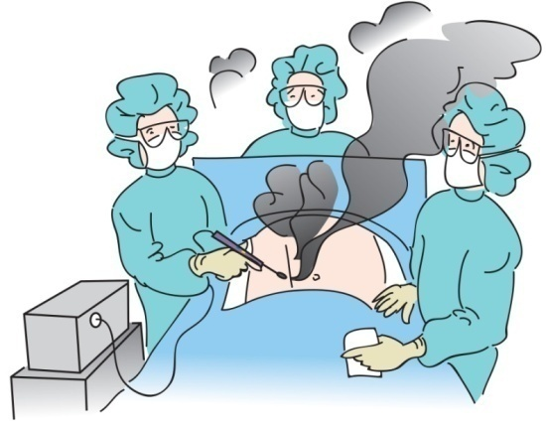
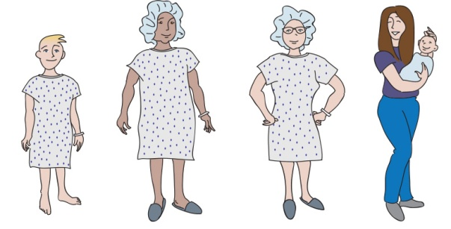
Potential Harm from Inhalation and Exposure
Patients
Perioperative team members
Others (eg, observers, industry representatives)
Notes:
There is potential for harm to the patient and the surgical team members from inhalation and exposure to surgical smoke. We know the smoke contents can include carbonized tissue, blood, viruses, and bacteria. We need to think about everyone in the OR during a procedure when energy-producing devices are generating surgical smoke. Everyone should be protected!

Slide 5
Hazards
Odor
Particulate matter
Viable/non-viable viruses or bacteria
Notes:
There are three main hazards associated with surgical smoke. These include the odor, the size of the particulate matter, and viability. If you smell the distinctive odor of surgical smoke, then you are being exposed to the potential hazards. The particulate matter in surgical smoke can cause respiratory problems, and the unfiltered particulate matter has the ability to clog suction lines. Surgical smoke may also contain viable organisms (eg, viruses, bacteria). Because of these hazards, smoke evacuation practices must be followed.

Slide 6
Inhaling Surgical Smoke
Using the CO₂ laser on 1 gram of tissue is like inhaling the smoke from three cigarettes in 15 minutes.
Using an ESU on 1 gram of tissue is like inhaling smoke from six cigarettes in 15 minutes.
Notes:
In 1981, Dr. Tomita and colleagues conducted a study that compared the inhalation of smoke from vaporized human tissue to the smoke created by cigarettes. The researchers determined that inhaling the smoke produced by vaporizing 1 gram of tissue (a small amount) with the CO₂ laser is similar to smoking three unfiltered cigarettes in a 15-minute period, and inhaling the smoke produced by vaporizing 1 gram of tissue with an electrosurgical device is similar to smoking six unfiltered cigarettes in 15 minutes. According to this study, smoke generated by using an electrosurgical device may be more hazardous than the smoke produced by a laser.¹
Reference
Tomita Y, Mihashi S, Nagata K, et al. Mutagenicity of smoke condensates induced by CO₂-laser irradiation and electrocauterization. Mutat Res. 1981;89(2):145-149.

Slide 7
Examples of Toxic Substances Found in Surgical Smoke
Acetaldehyde***
Acrolein
Acrylonitrile**
Benzene**
Butadiene***
Carbon monoxide
Cyanide
Ethanol
Formaldehyde**
Hydrogen cyanide
Methane
Phenol
Polycyclic aromatic hydrocarbons*
Toluene
*** Carcinogen
** Potential carcinogen
* Increased risk of certain cancers
Notes:
In 1976, Dr. Mihashi and colleagues reported that the effects of CO₂ laser irradiation caused a crater formation in the area, rapid vaporization of the water in the tissue, and dispersal of small charred tissue particles into the air. He reported there was no evidence as to whether the tissue in the dispersed particles was viable.¹
Since then, more than 150 chemical constituents and toxic substances have been identified in surgical smoke. Some of these substances are carcinogenic.² When tissue is pyrolyzed* with energy devices (eg, ESU, laser), toxic gases are produced that have an offensive odor. These gases exist in trace amounts in surgical smoke.
*pyrolysis: a chemical change brought about by the action of heat
References
Mihashi S, Jako GJ, Incze J, Strong MS, Vaughan CW. Laser surgery in otolaryngology: interaction of CO₂ laser and soft tissue. Ann N Y Acad Sci. 1976;267:263-294.
Pierce JS, Lacey SE, Lippert JF, Lopez R, Franke JE. Laser-generated air contaminants from medical laser applications: a state-of-the-science review of exposure characterization, health effects, and control. J Occup Environ Hyg. 2011;8(7):447-466.

Slide 8
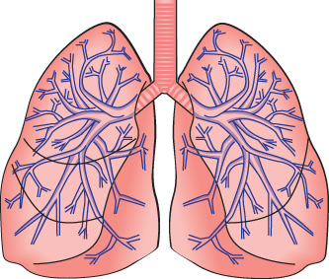
Particulate Matter
Carbonized tissue
Blood
Intact viruses and bacteria
human immunodeficiency virus (HIV)
human papillomavirus (HPV)
hepatitis
Notes:
Along with the toxic gases that create the surgical smoke odor, tiny particles are generated within surgical smoke that can easily be inhaled. These particles can consist of carbonized tissue, blood fragments, and possibly intact viruses or bacteria.

Slide 9
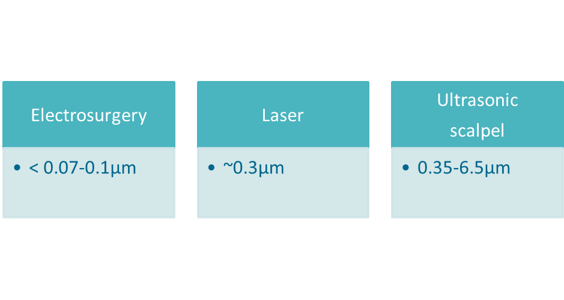
Particles
Particles generated by surgical energy devices are within the respirable range
Notes:
The particles in surgical smoke generated by surgical energy devices (eg, monopolar and bipolar electrosurgery, lasers) are within the respirable range.
Electrosurgery generates the smallest aerodynamic size particles (< 0.07 - 0.1 μm).
Laser tissue ablation creates larger particles (~ 0.3 μm).
Ultrasonic scalpels create the largest particles (0.35 - 6.5 μm).
μm = micrometer. 1 μm = 1 micron

Slide 10
Surgical Smoke Particle Sizes
Reprinted with permission from Guidelines for Perioperative Practice. Copyright © 2018, AORN, Inc, 2170 S. Parker Road, Suite 400, Denver, CO 80231. All rights reserved.
Notes:
The illustration demonstrates the size of the particles generated by the various energy devices; for example, particles generated by the laser are 0.3 micrometers. Larger particles deposit in the nasopharynx, and smaller particles generated by electrosurgical devices deposit in the alveoli of the lungs.
In Tokyo, at the International Society for Laser Surgery in 1981, Dr. Mihashi noted that 77% of the particles within surgical smoke are less than 1.1 micrometers in size.¹ Particles of this size can easily be deposited in the alveoli, the gas exchange regions of the lungs, which can lead to respiratory problems. Also, the circulating blood will pick up whatever is in the alveoli and circulate it randomly throughout the body.
Näslund Andréasson and colleagues analyzed the amount of airborne particles and ultrafine particles generated during surgery. Particles that are smaller than 0.1 micrometers in diameter are commonly defined as ultrafine. Particles of this size can be deposited in the alveoli. The researchers took personal and stationary samplings of ultrafine particles during peritonectomy procedures and colon and rectal cancer surgery, procedures that generate large amounts of surgical smoke. The personal sampling devices were 2 to 3 cm (approximately 1 inch) from the breathing area of the surgeon. The stationary devices were 3 meters or 9 feet from the smoke generation. The mean cumulative levels were statistically significant for personal and stationary samplings, signifying exposure for team members at the surgical field and non-scrubbed team members in the room. In discussing the results, the researchers compared the cumulative concentrations of ultrafine particles to smoking cigarettes or frying beef. They concluded that high levels of ultrafine particles generated by electrocautery devices can be a health risk and warrants further investigation.²
References
Mihashi S, Ueda S, Hirano M, Tomita Y, Hirohata T. Some problems about condensates induced by CO₂ laser irradiation. 4th Congress of the International Society for Laser Surgery. Society for Laser Medicine. Tokyo, Japan; 1981.
Näslund Andréasson S, Mahteme H, Sahlberg B, Anundi H. Polycyclic aromatic hydrocarbons in electrocautery smoke during peritonectomy procedures. J Environ Public Health. 2012;2012:929053.

Slide 11
Personal Protective Equipment (PPE)
Notes:
Perioperative team members should wear PPE (ie, respiratory protection) as secondary protection against residual surgical smoke. General room ventilation and smoke evacuation (ie, local exhaust ventilation) are the first lines of protection against the hazards of surgical smoke. When respiratory protection is required, the minimum respiratory protection device is a filtering face piece respirator (eg, an N95 respirator). A surgical N95 respirator is fluid resistant on the outside to protect the wearer from splashes or sprays of body fluids.
A surgical mask is a loose-fitting face mask intended to prevent the release of potential contaminants from the user into his or her immediate environment. A surgical mask is fluid resistant, providing protection from large droplets, sprays, and splashes of body fluids, but it does not give the wearer a reliable level of protection from inhaling small airborne particles. A surgical mask is not considered respiratory protection. A high-filtration surgical face mask is designed to filter particulate matter that is 0.1 micron in size and larger. Similar to a surgical mask, a high-filtration mask does not create a seal between the face and the mask and may allow dangerous contaminants to enter the health care worker’s breathing zone.
The evidence demonstrates the measurable superiority in protection provided by a surgical N95 respirator compared with high-filtration and surgical masks, and that surgical masks have inadequate filter performance for aerosols and submicron particles.

Slide 12
Particle Distribution
Smoke is evenly distributed throughout the OR
Smoke particles can travel about 40 mph
When the ESU is activated, the concentration of particles can increase from 60,000 particles/cubic foot to more than 1 million particles/cubic foot
It takes 20 minutes after the activation of the ESU for the concentration to return to the baseline level.
Notes:
In 2002, Nicola and colleagues found that surgical smoke is evenly distributed throughout the OR. Smoke particles can travel about 40 mph. The researchers reported when the ESU is activated, the concentration of the particles can increase from 60,000 particles per cubic foot to more than 1 million particles per cubic foot. After activation of the ESU and generation of surgical smoke, the concentration of particles returns to the baseline level after about 20 minutes.¹
Reference
1. Nicola JH, Nicola EM, Vieira R, Braile DM, Tanabe MM, Baldin DH. Speed of particles ejected from animal skin by CO₂ laser pulses, measured by laser Doppler velocimetry. Phys Med Biol. 2002;47(5):847-856.

Slide 13
Surgical Smoke: It’s a Universal Concern
Weston R, Stephenson RN, Kutarski PW, Parr NJ. Chemical composition of gases surgeons are exposed to during endoscopic urological resections. Urology. 2009;74(5):1152-1154.
Lester JD, Hsu S, Ahmad CS. Occupational hazards facing orthopedic surgeons. Am J Orthop (Belle Mead NJ). 2012;41(3):132-139.
Hill DS, O’Neill JK, Powell RJ, Oliver DW. Surgical smoke—a health hazard in the operating theatre: a study to quantify exposure and a survey of the use of smoke extractor systems in UK plastic surgery units. J Plast Reconstr Aesthet Surg. 2012;65(7):911-916.
Ball K. Surgical smoke evacuation guidelines: compliance among perioperative nurses. AORN J. 2010;92(2):e1-e23.
Lewin JM, Brauer JA, Ostad A. Surgical smoke and the dermatologist. J Am Acad Dermatol. 2011;65(3):636-641.
Notes:
There are many health care articles about surgical smoke. Surgical smoke concerns are universal and affect all types of surgical services, including inpatient settings, ambulatory surgery settings, and office-based settings. It’s also important to note that surgical smoke affects both patients and health care workers.

Slide 14
Patient Safety

Slide 15
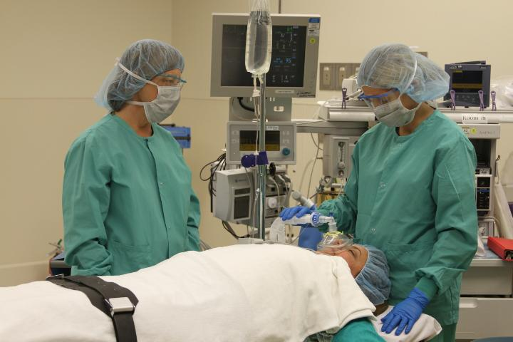
Patient Safety: Exposures to Surgical Smoke
Laparoscopic procedures present unique exposures to surgical smoke.
Notes:
Let discuss surgical smoke exposures that affect surgical patients. During a laparoscopic procedure, the patient is exposed surgical smoke in the abdomen when energy-based devices are used (eg, electrosurgery, laser, ultrasonics). This presents a unique set of problems associated with the patient absorbing surgical smoke.

Slide 16
Minimally Invasive Surgery (MIS)
Levels of carboxyhemoglobin were significantly elevated in patients who underwent laparoscopic procedures using a laser.
Notes:
As smoke builds up inside the abdomen during laparoscopy, the smoke is absorbed through the patient’s peritoneal membrane. When the smoke is absorbed by red blood cells (RBCs), an increase in carboxyhemoglobin and methemoglobin can occur.^{1,2}
References
Beebe DS, Swica H, Carlson N, Palahniuk RJ, Goodale RL. High levels of carbon monoxide are produced by electro-cautery of tissue during laparoscopic cholecystectomy. Anesth Analg. 1993;77(2):338-341.
Ott DE. Carboxyhemoglobinemia due to peritoneal smoke absorption from laser tissue combustion at laparoscopy. J Clin Laser Med Surg.1998;16(6):309-315.

Slide 17
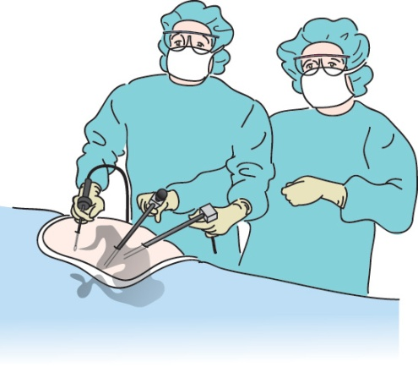
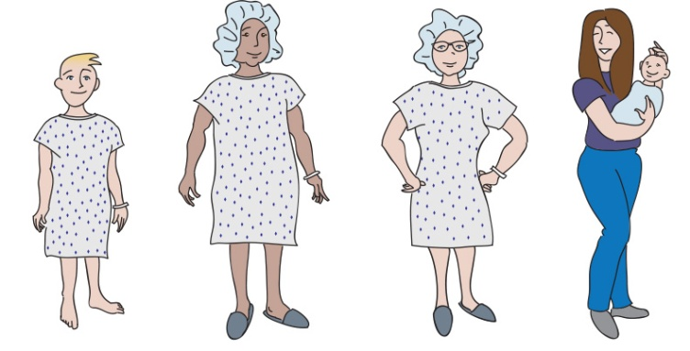
Laparoscopic Surgical Procedures
Pulse oximeter readings may be falsely elevated and could result in unrecognized patient hypoxia.
Notes:
Carboxyhemoglobin and methemoglobin are modified forms of hemoglobin. Both of these substances reduce or deplete the oxygen-carrying capacity of the RBCs, and these substances remain within the patient’s body throughout the life of the RBCs.^{1,2} As a result of the increases in these substances, a potential hazard for the patient may occur because the pulse oximeter readings may be falsely elevated and could result in unrecognized patient hypoxia.³
References
Beebe DS, Swica H, Carlson N, Palahniuk RJ, Goodale RL. High levels of carbon monoxide are produced by electro-cautery of tissue during laparoscopic cholecystectomy. Anesth Analg. 1993;77(2):338-341.
Ott DE. Carboxyhemoglobinemia due to peritoneal smoke absorption from laser tissue combustion at laparoscopy. J Clin Laser Med Surg.1998;16(6):309-315.
Ott DE. Smoke and particulate hazards during laparoscopy procedures. Surgical Services Management. 1997;3(3):11-13.

Slide 18
Laparoscopic Surgical Procedures
Carbon monoxide levels may increase in the peritoneal cavity and exceed recommended exposure limits.
Notes:
Carbon monoxide levels may increase as well, exposing both the patient (during the procedure) and the perioperative team (when the insufflated gas is released into the OR) to higher than recommended exposure limits.^{1,2}
References
Beebe DS, Swica H, Carlson N, Palahniuk RJ, Goodale RL. High levels of carbon monoxide are produced by electro-cautery of tissue during laparoscopic cholecystectomy. Anesth Analg. 1993;77(2):338-341.
Ott DE. Carboxyhemoglobinemia due to peritoneal smoke absorption from laser tissue combustion at laparoscopy. J Clin Laser Med Surg.1998;16(6):309-315.

Slide 19
Exposure to Surgical Smoke During MIS: Risks to Patients
Exposure to carbon monoxide
Increased levels of carboxyhemoglobin
Occurrence of methemoglobin
Loss of visibility in the surgical field or potential delay of the procedure
Port-site metastasis
Notes:
In addition to the physiological changes reviewed in the previous slides, there are additional risks to patients who are exposed to surgical smoke during minimally invasive procedures. There is a potential for smoke to interfere with the surgeon’s ability to see the surgical field, and this may delay or prolong the surgical procedure. Adjusting the gas flow rate and using equipment to remove smoke while the procedure is in progress will help maintain the pneumoperitoneum and the visibility of the surgical field. Another potential risk to patients is the development of a port-site metastasis.

Slide 20
Exposure to Surgical Smoke During MIS: Risks to Patients
Exposure to carbon monoxide
Increased levels of carboxyhemoglobin
Occurrence of methemoglobin
Loss of visibility in the surgical field or potential delay of the procedure
Port-site metastasis
Notes:
Fletcher and colleagues theorized that if malignant tissue is cauterized and aerosolized inside the abdomen, the cancerous cells could reimplant at another site. They found that when electrocautery is applied to melanoma cells, viable cells were released into the smoke plume that could be grown in culture. This could explain port metastases at sites that were not in direct contact with the tumor.¹ This theory is supported by another study that found viable tumor cells are produced in the surgical smoke from tumor dissection by ultrasonic scalpel.²
References
Fletcher JN, Mew D, DesCoteaux JG. Dissemination of melanoma cells with electrocautery plume. Am J Surg. 1999;178(1):57-59.
In SM, Park DY, Sohn IK, et al. Experimental study of the potential hazards of surgical smoke from powered instruments. Br J Surg. 2015;102(12):1581-1586.

Slide 21
Health Care Worker Safety

Slide 22
Worker Safety: Exposures to Smoke/Plume
“Each year, an estimated 500,000 workers, including surgeons, nurses, anesthesiologists, and surgical technologists, are exposed to laser or electrosurgical smoke.”
Laser/Electrosurgery Plume. Occupational Safety and Health Administration (OSHA). US Department of Labor. https://www.osha.gov/SLTC/laserelectrosurgeryplume/index.html. Accessed April 13, 2018.
Notes:
OSHA, a part of the US Department of Labor, publishes statistics on worker exposures to laser and surgical smoke.

Slide 23
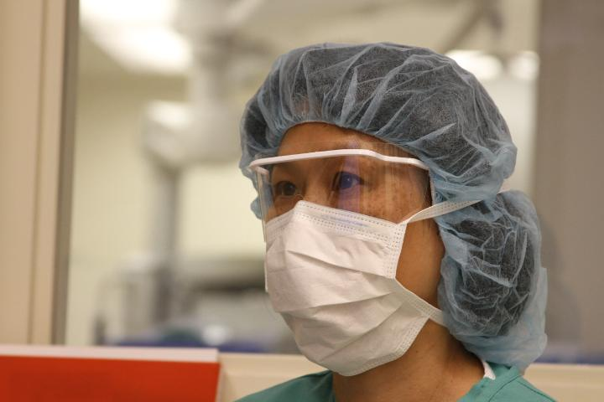
Air Pollution and Women
Long time exposure to fine particulate air pollution is associated with the incidence of cardiovascular disease and death among postmenopausal women.
1
Notes:
Miller and colleagues reported that long time exposure to fine particulate air pollution is associated with the incidence of cardiovascular disease and death among postmenopausal women.¹ Their study’s findings represent a major concern for postmenopausal women working in the OR and inhaling surgical smoke on a regular basis.
Reference
Miller KA, Siscovick DS, Sheppard L, et al. Long-term exposure to air pollution and incidence of cardiovascular events in women. N Engl J Med. 2007;356(5):447-458.

Slide 24
Health Effects Reported by Health Care Workers
Eye, nose, throat irritation
Headaches
Nausea, dizziness
Runny nose
Coughing
Respiratory irritants
Fatigue
Skin irritation
Allergies
Notes:
When surgical smoke is inhaled, health care workers can experience nausea, dizziness, watery eyes, runny nose, headaches, fatigue, respiratory problems, skin irritation, and allergies. These symptoms can be minimized and possibly eliminated with correct smoke evacuation practices.

Slide 25
Respiratory Problems
Perioperative nurses have twice the incidence of many respiratory problems compared to the general population.
Allergies
Sinus infections/problems
Asthma
Bronchitis
Notes:
In a research study, perioperative nurses reported twice the incidence of many respiratory problems compared to the general population.¹
Reference
1. Ball K. Compliance with surgical smoke evacuation guidelines: implications for practice. AORN J. 2010;92(2):142-149.

Slide 26
Case Report
A 44-year-old laser physician developed laryngeal papillomatosis.
A biopsy identified the same virus type as anogenital condyloma.
Notes:
There is a potential for the transmission of viable organisms found in surgical smoke.
In a 1991 study, researchers reported that a 44-year-old surgeon, who rarely evacuated the surgical smoke when using the laser to vaporize condyloma, developed laryngeal papillomatosis. When his lesions were biopsied, the same type of virus was identified that is found in anogenital warts and is not normally found in the throat. This report, along with other anecdotal reports continue to support that best practice is to evacuate and filter surgical smoke.¹
Reference
Hallmo P, Naess O. Laryngeal papillomatosis with human papillomavirus DNA contracted by a laser surgeon. Eur Arch Otorhinolaryngol. 1991;248(7):425-427.

Slide 27
Exposure to Surgical Smoke during MIS: Perioperative Team Members
Health effects to the perioperative team
When pneumoperitoneum is released into the OR without filtration
Important to use a filtering device or a closed evacuation system
Notes:
It is important to remember that when the pneumoperitoneum is released during or at the end of the surgical procedure, a filtering device should be used to protect the perioperative team members from exposure to the surgical smoke. There are also smoke evacuators available for use to de-insufflate the abdomen using a closed system.

Slide 28
Summary Part II
Surgical smoke is a hazard to patients and health care providers.
Particulate matter in surgical smoke can contain carbonized tissue, blood, and intact viruses and bacteria (eg, HIV, HPV, Hepatitis B and C).
Patients and health care providers are also at unique risks from surgical smoke during minimally invasive surgical procedures.

Slide 29
End of Part II
Please continue to the next slide deck: Part III
Part I: Introduction to Surgical Smoke
Part II: The Hazards of Surgical Smoke
Part III: An Overview of Health Care Regulations, Standards, and Guidelines Related to Surgical Smoke
Part IV: Smoke Evacuation in the Perioperative Setting
Part V: Additional Perioperative Nursing Care

